Slide 1

SE Mini Project Title
Sustainable Goal:
Project Mentor : Veena Trivedi
Group Number : 37
Group Members :
Yashkumar Sajda, Ritik Shetty, Shivam Pandey, Jassim

Slide 2
Content
Introduction
Problem Definition
Goals/ Objectives
Survey of Existing System
Limitation Existing system or research gap
Details of Hardware & Software
Proposed System: Introduction
Architecture/ Framework (Block Diagram, Conceptual Diagram, ER Diagram)
Algorithm and Process Design
Implementation details(GUI Screenshot, Dataset Used)
Results Obtained
Evaluation Measures
Conclusion and Future Scope
References

Slide 3
Introduction to Project
NFC (Near Field Communication) technology is a wireless communication method that enables short range data exchange between devices by simply bringing them close together, facilitating various applications like contactless payments and data transfer.
NFC technology works through electromagnetic fields and radio waves. It operates in two primary modes: active and passive. In active mode, one NFC device generates an RF (Radio Frequency) field, while the other device, typically a passive NFC tag or card, responds to the field by drawing power from it and transmitting data back.
In passive mode, both devices generate their own RF fields, allowing them to communicate by modulating these fields. NFC operates at close proximity, typically within a few centimetres, making it a secure and convenient technology for tasks like contactless payments, data transfer, and access control. It uses high-frequency radio waves (13.56 MHz) and is widely employed in smartphones, smart cards, and various IoT applications.

Slide 4
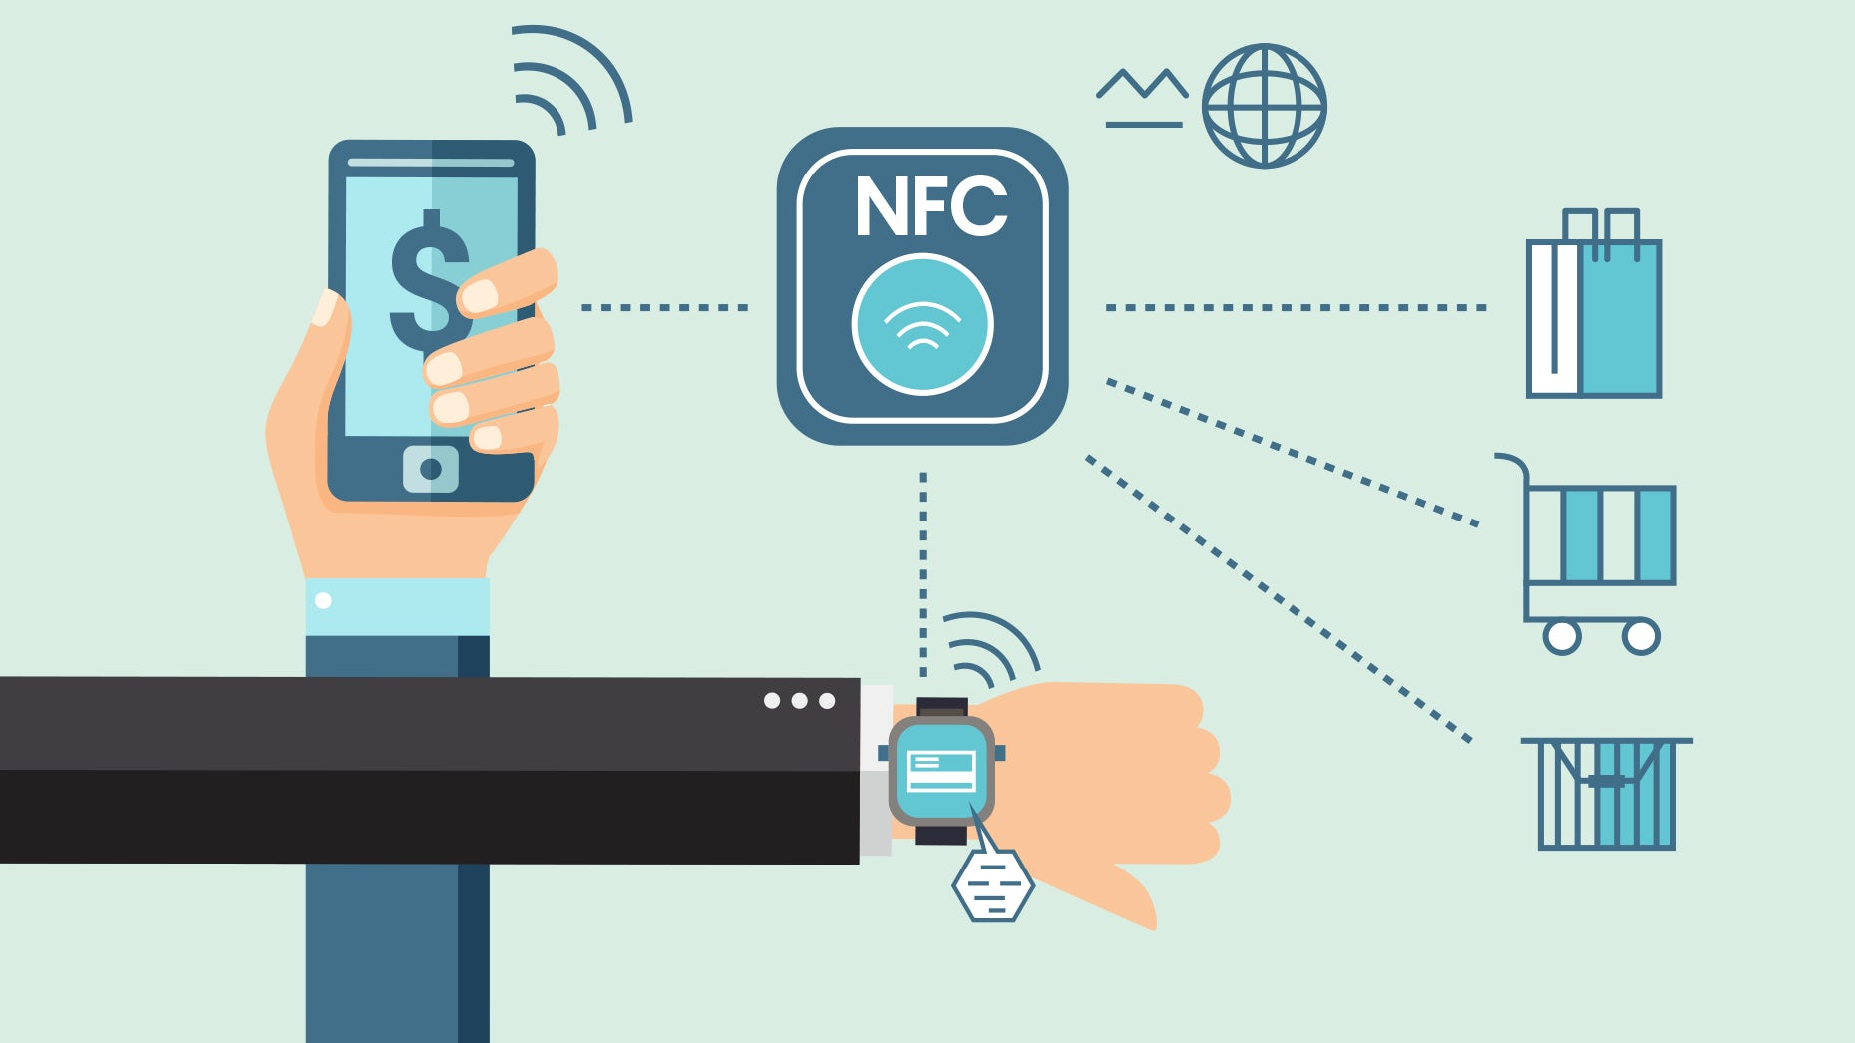
Applications
Contactless Payments.
Access control systems.
Ticketing and transit.
Data transfer between devices.
Smart posters and advertisements.

Slide 5
Problem Definition
PROBLEM:
Companies usually use visiting cards to share their contact information. These cards are used by almost every companies.
This causes wastage of resources like paper, ink, etc.
Also, manufacturing huge amount of visiting cards is too much time consuming.
Visiting cards typically have limited space, so you can only include essential contact information.
Handing out physical cards can be cumbersome and may result in lost or misplaced cards.
If your contact information changes (e.g., phone number, email address), you'll need to print new visiting cards.

Slide 6
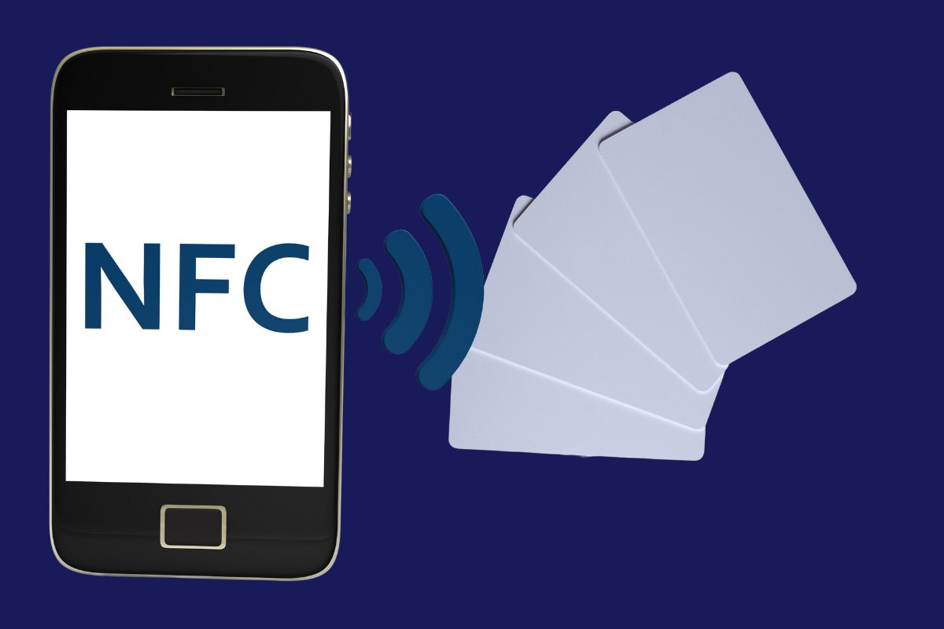
Proposed System
NFC enabled contact cards serves as a perfect alternative. Firstly, a website is created using HTML, CSS, JavaScript. A database is connected to the site. The user has access to all the contact information collected through NFC cards in this database. Then, an NFC card is used to hold the information in the website. As soon as someone taps an NFC card to an electronic device, the contact information gets stored in the database. Through which one can sort their contact information according to their corresponding work field, company name, etc.

Slide 7
Goals
The goals which are supposed to be fulfilled through this project:
To provide efficient contact sharing.
To prioritize convenience of the customer.
To be able to create dynamic digital profiles to be linked with NFC contact cards.
To reduce the environmental impact on the surroundings.
To provide secure data transfer.
To provide a cost-effective solution.

Slide 8
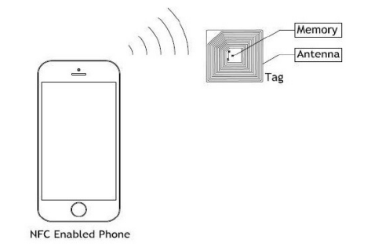
Literature Survey
Near field Communication(NFC) is one of the emerging technologies currently in use. It works on the principle of magnetic induction to commence communication between electronic devices in close vicinity. According to a survey conducted by Vedat Coskun, Busra Ozdenizci, Kerem, “With NFC technology, communication is established when an NFC-compatible device is brought within a few centimetres of another i.e. around 20 cm theoretically (4cm is practical)”. Average frequency of operation for NFC cards is 13.56MHz and the maximum data transfer rate is 424kbps.
Ref: International Journal on Cybernetics & Informatics (IJCI) Vol. 4, No. 2, April 2015

Slide 9
Literature Survey
The device which sends the signal is known as the initiater, whereas the device which responds to the initiater’s request is known as the target. In NFC technology, the communication is initiated using NFC but the transmission is done using some other methods like WiFi /Bluetooth. The handover mechanisms specified by the NFC forum are:
Static handover.
Negotiated handover.
1) Negotiated handover: In this method, the initiater sends over a handover request to the target device which may support various features like WiFi/Bluetooth. Target sends a response to the requester, i.e initiater. NFC requester device finds the best possible path for the transmission of data which is compatible for both the devices accordingly.
2) Static handover: In this method, handover selector device does not comprise an NFC Forum device but has a NFC Forum tag attached which gives memory space that can be read or written.
Ref: International Journal on Cybernetics & Informatics (IJCI) Vol. 4, No. 2, April 2015

Slide 10
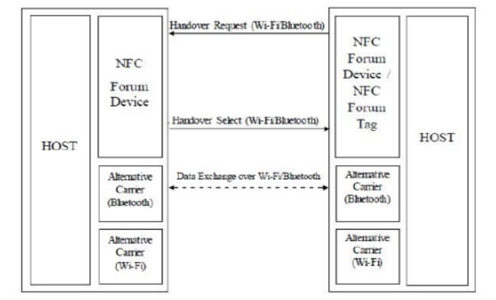
Literature Survey
Ref: International Journal on Cybernetics & Informatics (IJCI) Vol. 4, No. 2, April 2015

Slide 11
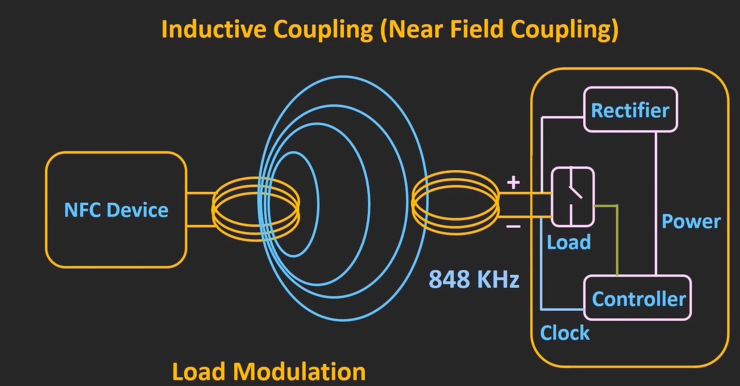
Literature Survey
WORKING OF NFC TECHNOLOGY:
NFC enabled devices communicate with each other using radio waves. These radio waves are generated through antennas (in case of mobile, antenna at the back of the battery or cover).
NFC technology works on mainly 3 modes which are:
Peer-to-Peer communication mode:
The example for this mode of communication is sharing of information between two mobile devices. In this mode, both devices are active. When a mobile device acts as an initiater the other acts as a target and vice versa.
Ref: International Journal on Cybernetics & Informatics (IJCI) Vol. 4, No. 2, April 2015

Slide 12
Literature Survey
Reader/Writer mode:
The example for this mode of communication is accessing the data or information of a NFC tag using a mobile phone. In this mode the active device like smart phone or tablet reads or writes the data on the NFC tag using the principle of Magnetic Induction. To read the information from the NFC tag, the active device generates radio waves at the carrier frequency of 13.56MHz. These waves get coupled to the antenna of the passive NFC tag and hence transfer of energy in the form of electromagnetic rays takes place. This time varying electromagnetic rays induces emf in the NFC tag. The generated voltage is then rectified and it is used to power up the chip in the NFC tag. This small chip generally comprises of EEPROM (Electrically Erasable Programmable Read-only Memory), clock, rectifier circuit and a small controller. The target responds to the initiater using Load Modulation. In this technique, the tag uses the internal clock of the chip and it generates the auxillary carrier frequency of 848kHz. Depending upon the stored data inside the chip, the load which is connected in parallel to the antenna is turned ON and OFF.
Ref: International Journal on Cybernetics & Informatics (IJCI) Vol. 4, No. 2, April 2015

Slide 13
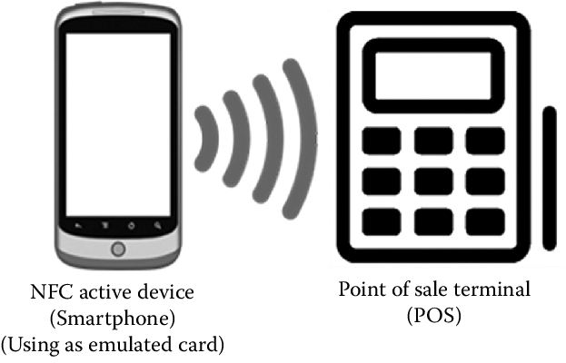
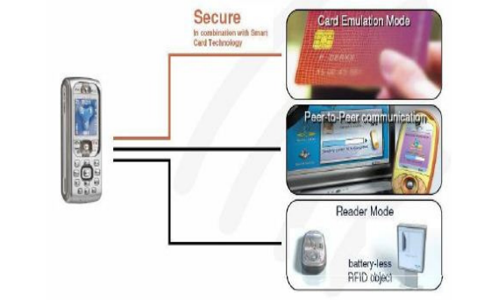
Literature Survey
Card Emulation Mode:
An example for this mode of communication is mobile payment using smart phones. Here, 2 active devices are in work: mobile phone and payment terminal. In a way, smart phones act like a passive device. The operating principle of this mode is quite similar to the Reader/Writer mode.
Ref: International Journal on Cybernetics & Informatics (IJCI) Vol. 4, No. 2, April 2015

Slide 14
Limitation of Existing system or research gap
LIMITED RANGE OF NFC –
NFC typically has a range of a few centimeters, which could be a limitation if longer-range communication is required.
SECURITY CONCERNS –
Depending on the application, there might be security concerns with NFC cards, such as the potential for eavesdropping or unauthorized access.
DATA TRANSFER SPEED –
NFC has a relatively slower data transfer speed compared to other wireless technologies like Bluetooth or Wi-Fi. This could be a limitation if high-speed data exchange is needed.
COMPATIBILITY AND STANDARDISATION –
Ensure that the NFC technology used is compatible with a wide range of devices and adheres to established standards to avoid compatibility issues.

Slide 15
Hardware, Software, Tools and constraint
HARDWARE –
RFID Tags
RFID Reader
RFID Writer
QR Generator
Thermal Printer
SOFTWARE –
Front end:
HTML
CSS
JavaScript
Back end:
SQL
PHP

Slide 16
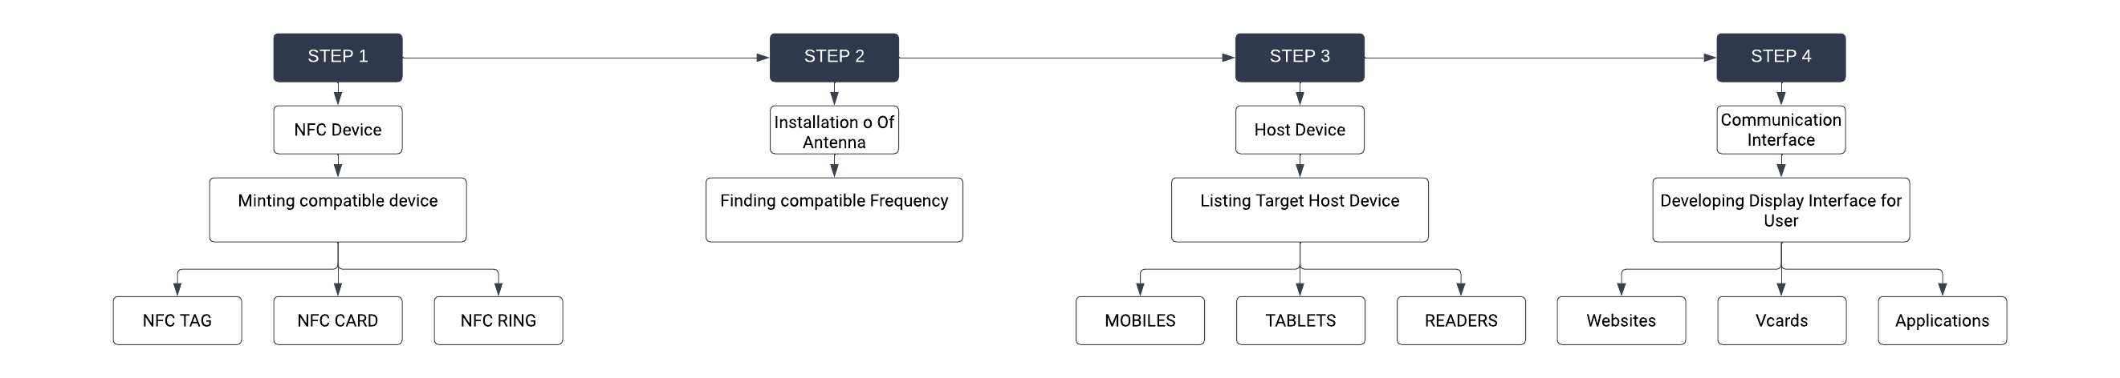
Architecture/ Framework (Block Diagram, Conceptual Diagram, ER Diagram)

Slide 17
Methodology : Algorithm and Process Design
Designing NFC (Near Field Communication) products involves several key steps to ensure that the final product functions effectively and meets the desired specifications. Below is a process design for creating NFC products using NFC technology:
**1. Define Product Requirements:**
Begin by clearly defining the requirements of your NFC product. This includes determining the intended use, target audience, and specific features and functionalities you want to incorporate. Identify the problem your product aims to solve or the value it provides to users.
**2. Market Research:**
Conduct market research to understand the demand for NFC products in your target market. Identify competitors, trends, and potential opportunities. This research will help refine your product concept and positioning.
**3. Conceptual Design:**
Create a conceptual design of your NFC product. This should include rough sketches or digital mock-ups of the product's physical or digital interface. Consider how NFC technology will be integrated into the design and how users will interact with it.
**4. NFC Chip Selection:**
Choose the appropriate NFC chip or module based on your product's requirements. Consider factors like communication range, data storage capacity, security features, and compatibility with the NFC standards (e.g., NFC Forum standards).
**5. Hardware Design:**
Develop the hardware components of your NFC product. This includes designing the physical enclosure, antenna, and power supply. Ensure that the NFC chip is properly integrated into the hardware.

Slide 18
Methodology : Algorithm and Process Design
**6. Software Development:**
Develop the software that will control and interact with the NFC chip. This may include developing mobile apps, firmware for embedded systems, or web-based interfaces for configuration and data retrieval.
**7. NFC Tag Programming:**
Program NFC tags or cards with the necessary information or commands. This may involve encoding data onto NFC tags, setting up access controls, and defining actions that should occur when a tag is scanned.
**8. Testing and Prototyping:**
Create prototypes of your NFC product for testing and validation. Test the product's NFC functionality, data transfer, and user experience. Address any issues or limitations that arise during testing and make necessary improvements.
**9. Compliance and Certification:**
Ensure that your NFC product complies with relevant industry standards and regulations, such as NFC Forum specifications and regional certification requirements. Seek certification if necessary.
**10. Manufacturing and Production:**
Once you have a validated design, initiate the manufacturing process. Source components, choose production methods, and set up quality control processes to ensure consistent product quality.

Slide 19
Methodology : Algorithm and Process Design
**11. User Documentation and Support:**
Create user manuals, guides, and documentation to help users understand how to use your NFC product effectively. Establish customer support channels to address user inquiries and issues.
**12. Distribution and Marketing:**
Develop a distribution strategy to get your NFC product into the hands of customers. Implement marketing and promotional activities to create awareness and drive sales.
**13. Post-Launch Monitoring and Improvement:**
Continuously monitor the performance and user feedback of your NFC product after its launch. Collect data on how users are interacting with it and use this information to make iterative improvements.
**14. Security Considerations:**
Throughout the design process, pay special attention to security. Protect sensitive data transmitted via NFC and ensure that your product is resistant to attacks or unauthorized access.
**15. Future Development:**
Consider the possibility of future updates or iterations of your NFC product to keep it competitive and relevant in the market.
The process outlined above is a general framework for designing NFC products using NFC technology. The specific steps and considerations may vary depending on the nature of your product and the industry in which it operates. Additionally, collaboration with experts in NFC technology and product design is often crucial for success in this field.

Slide 20
Implementation details(GUI Screenshot, Dataset Used)
Database is created using SQL query language. The database contains two tables namely – personal details and company details. It includes contact information of people inputted by the NFC card.
DATABASE:
personal_details :
Primary key – id
Secondary key – work_id
company_details:
Primary key – work_id

Slide 21

Personal details table –

Slide 22
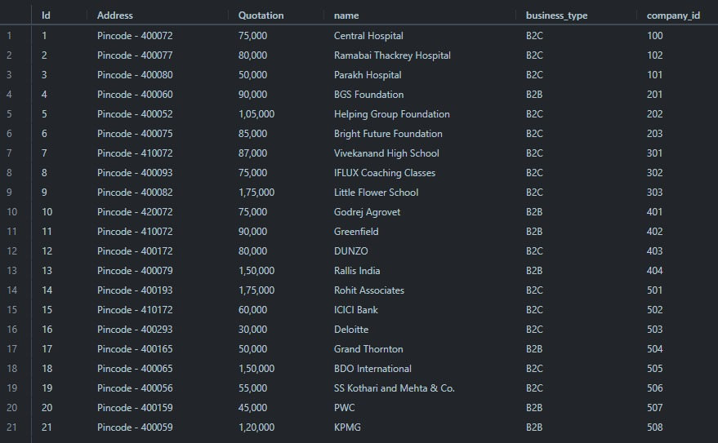
Company details table –

Slide 23
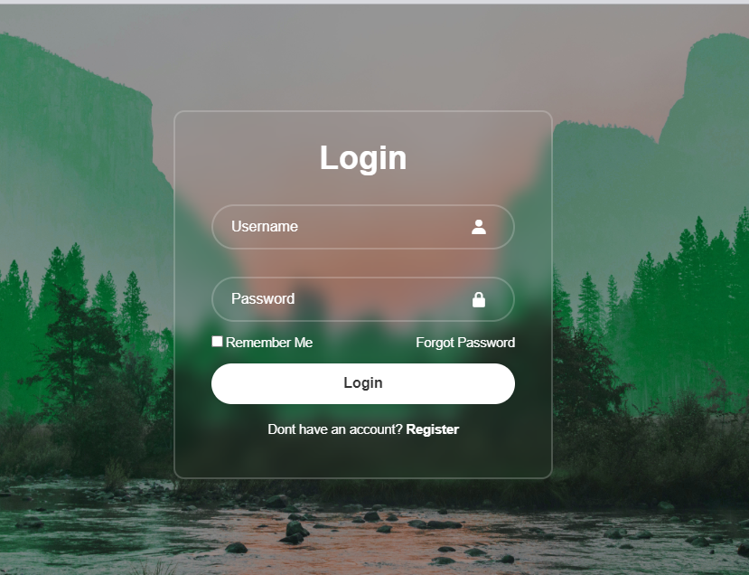
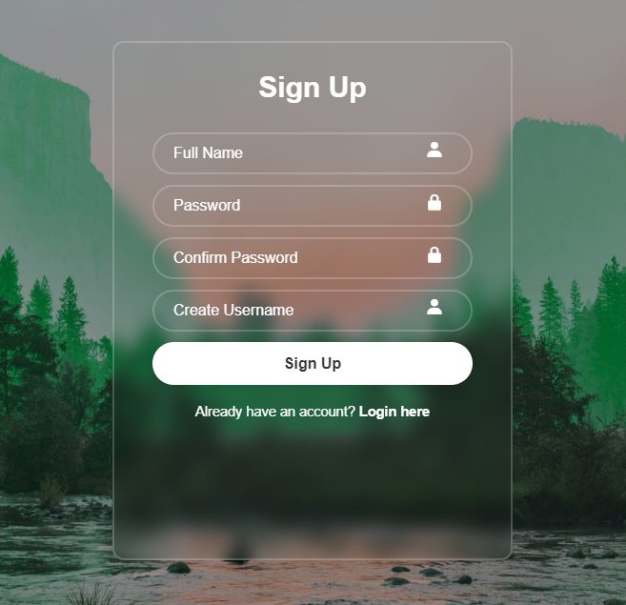
Login page -

Slide 24
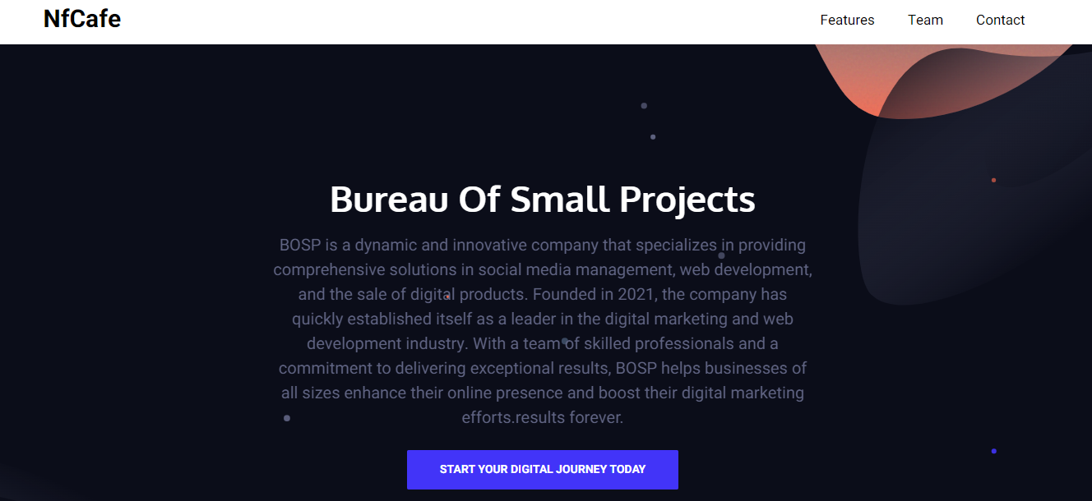
Customization page

Slide 25
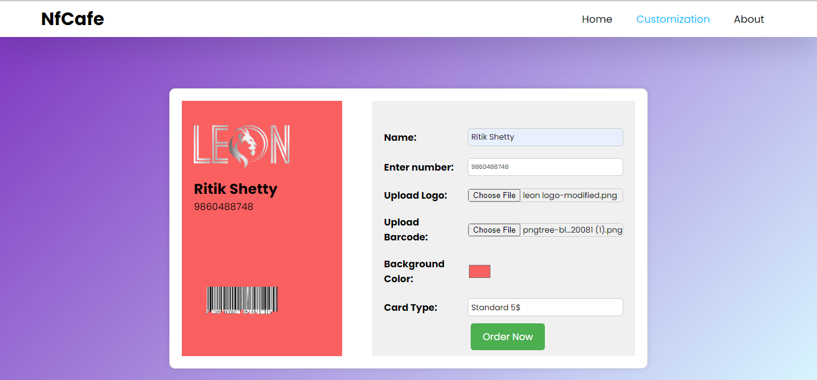
Shopping Page

Slide 26
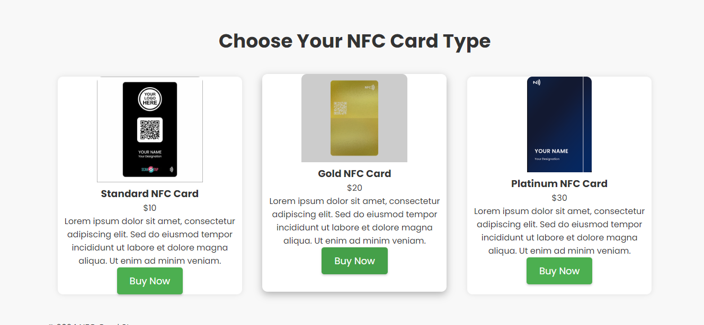
Shopping Page

Slide 27

Shopping Page

Slide 28
Results Obtained
Time taken for pairing of two devices (connectivity time) = 0.2 sec
Successful in creating dynamic digital profiles.
Data transfer rate is moderate.
RF frequency used in NFC contact card = 13.56 MHz
Minimum distance between devices for successful connection = 4 cm

Slide 29
Conclusion and Future Scope
In conclusion, NFC (Near Field Communication) contact cards offer a modern and efficient solution for sharing contact information in our increasingly digital world. These cards can streamline the process of exchanging details, enhance professionalism, and provide real-time updates, all while reducing environmental impact and offering multimedia integration options. While they may not be suitable for every situation and audience, NFC contact cards are a valuable tool for those seeking a convenient, eco-friendly, and tech-savvy way to connect and network. As technology continues to advance, NFC contact cards remain a relevant and innovative option for individuals and organizations looking to make a lasting impression and manage their contacts more effectively.
FUTURE SCOPE –
Access Control and Security
Healthcare and Medical Records
Wearable Technology

Slide 30
References
CITATION:
TY - JOUR
AU - Rahul, Anusha
AU - Krishnan, Gokul
AU - H, Unni
AU - Rao, Sethuraman
PY - 2015/04/30
SP - 133
EP - 144
T1 - Near Field Communication (NFC) Technology: A Survey
VL - 4
DO - 10.5121/ijci.2015.4213
JO - International Journal on Cybernetics & Informatics
REFERENCES:
NFC, Wikipedia, Available: http://en.wikipedia.org/wiki/Near_field_communication
NFC-Forum, Available: http://www.nfc-forum.org
NFC, YouTube, Available: https://youtu.be/eWPtt2hLnJk?feature=shared

